Slide 1
DSC Predictive Model:
Who will donate?
By: Deborah Kewon and Patrick Dundon

Slide 2
Outline
Patrick
Defining the objective​
The timeline​
Which models were evaluated?
Deborah
4. Chosen model and variables included​
5. Visualization of model results​
6. Business Implications

Slide 3
Defining the objective
Look at previous donor data
Predict who will donate at least 35 EUR to upcoming reactivation campaign​
Use python model to determine who to target and how to maximize resources

Slide 4
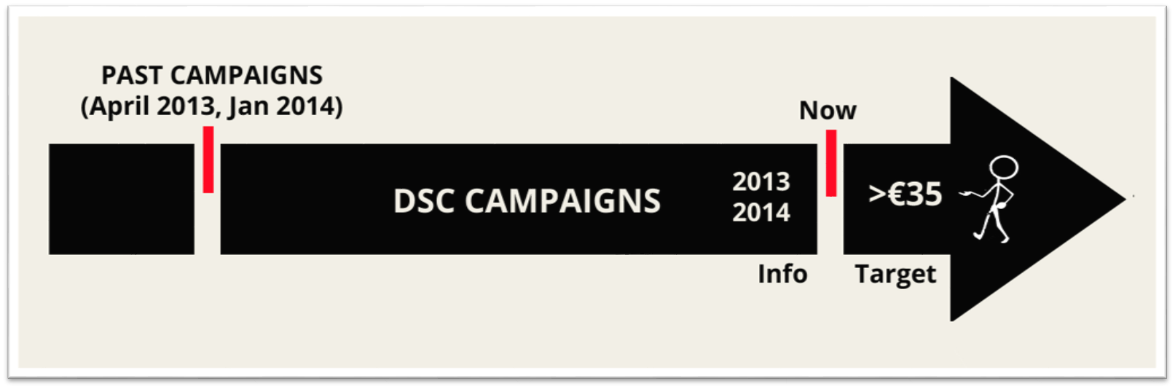
The timeline
*Historical donor data was considered dating back as far as 5 years (2008)

Slide 5
Which models were evaluated?
Model | Score
Decision Tree | 100.00
Random Forest | 99.98
Support Vector Machine | 96.51
Logistic Regression | 96.50

Slide 6
Chosen model and variables included
Based on forward variable stepwise selection, we select:​
1) minimum amount of gifts in past 5 years​
2) maximum amount of gifts in past 5 years​
3) average amount of gifts in past 5 years​
4) language F​
5) total amount of gifts in past 5 years

Slide 7
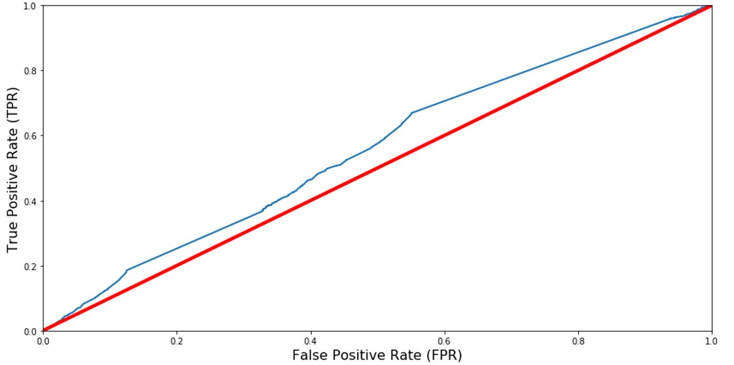
Visualization of model results
AUC:0.56

Slide 8
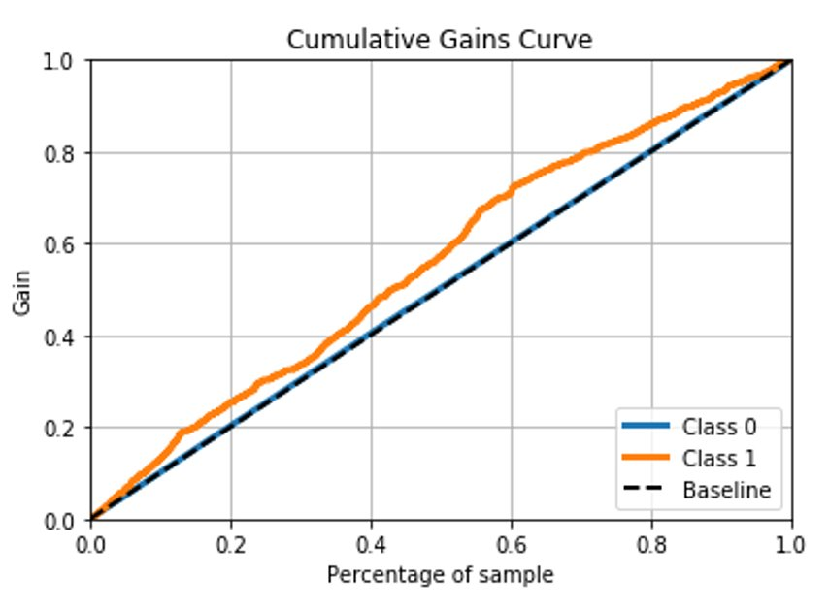
Visualization of model results
The top 40% of samples made more than 50% of the donations.

Slide 9
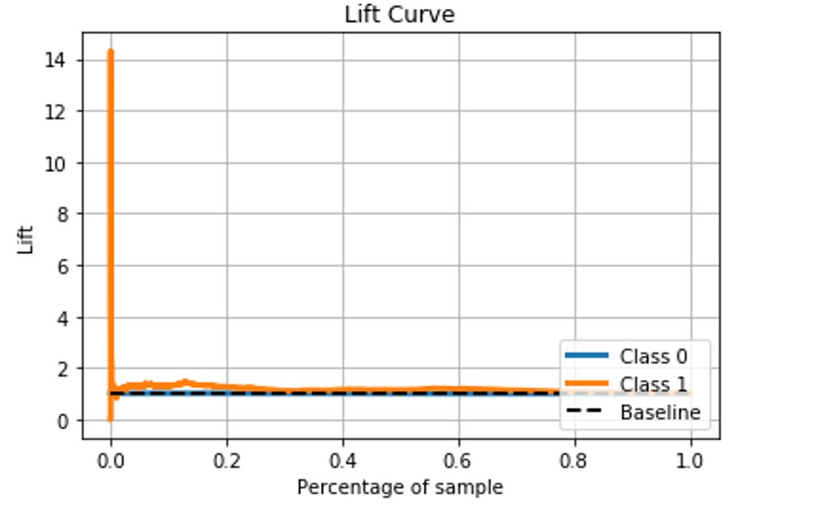
Visualization of model results
Compared to a random choice targeting model, our targeting model has a slightly better response rate given 24,000 number of samples (40%)

Slide 10

Business Implications​
Assumed campaign budget = €10.000 ​
*based on previous campaign list of 25.000 potential donors, cost of €0,50 per campaign letter, labour costs ​
Target incidence = 3%​
Percentage of potential donors reachable = 40% (10.000)​
​
Notes:
*donors selected = 10000*0.03 = 300

Slide 11
€7,600
Potential campaign profit
Notes:
*does not account for extra expenses such as labour

Slide 12
Model Takeaways
Identifies the donor characteristics that may positively influence donation rate
Ex: French-speaking Belgians appear more likely to donate than Dutch-speaking Belgians
​Improves marketing efficiency by identifying and targeting those with higher donation probability

Slide 13
Thanks!
Any questions ?

